Slide 1

Week 3 - Administrative stuff
Read textbook chapter 9
Programming assignment #1: Warboats
    Due Thursday, February 5th – before 6 pm
Next week: no class on Tuesday

Slide 2


Linked lists
CS170 – Lecture 6

Slide 3
Arrays
Most basic (and important!) data structure
Pros:
    Built-in to the language
    Easy to create at compile time or runtime
    Accessing any element in the array is trivial
    (just use an index)
    Easy to "clean up"
    (Static arrays, just forget about it; dynamic, use delete[])

Slide 4
Arrays
Most basic (and important!) data structure
Cons:
    You need to know size ahead of time
    (both static and dynamic arrays)
    You must allocate a fixed amount of space
    (can't resize an array)
    Inserting and deleting anywhere but at the end requires a lot of work

Slide 5
Arrays
Most basic (and important!) data structure
Rough edges:
    No bounds checking, allowing you to overwrite memory
    The unusual pointer-array relationship

Slide 6
Array limitations: example
Reading integers from a file into an array:
    Allocate an array to hold the numbers
    Open a file for reading
    While there are more numbers in the file
      Read in a number
      Add it to the end of the array
    Close the file

Slide 7
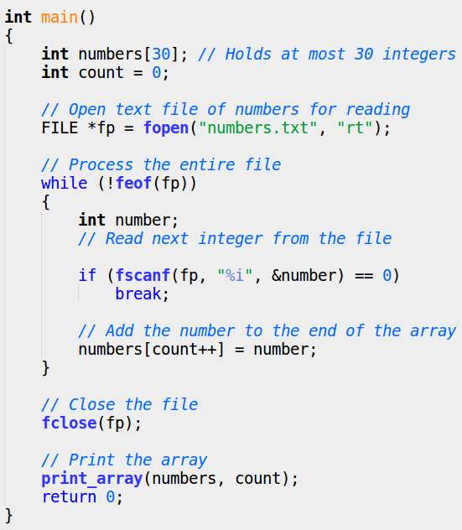
Array limitations: example

Slide 8
Array limitations: example
Doesn't work for >30 numbers
Possible workarounds:
    Don't read in more than 30 numbers
    Set the size of the array to more than 30 → potential waste
    Allocate the array at runtime
      Put the size in the file. (Maybe the first line contains the number of integers.) Allocate the array when the size is known
      When the array is full, allocate another, bigger array, and copy old values into it. This may need to be done many times

Slide 9
Linked lists
A dynamic collection of elements called nodes
A node is a struct or class in C++
A node has two main portions
    data portion: same type (size) of information in all nodes
    pointer portion: a pointer to the next node in the list

Slide 10
Linked lists
The data portion can be as simple as an int or very complex
The linked list is accessed through an external pointer called the head which points to the first node in the list
The last pointer in the list points to 0 (NULL), marking the end of the list

Slide 11
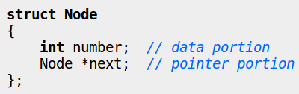
Linked lists
An example of a node structure (for a singly linked list) that contains an integer as it's data:

Slide 12
Linked lists
Example showing data as an integer, each node is 8 bytes
Example showing arbitrary addresses

Slide 13
Linked lists
If the list is empty, head points to 0 (NULL)
If each node in the list has only one pointer (called a "next" pointer), the list is called a singly linked list
Some lists have nodes with two pointers
    called "next" and "previous"
    doubly linked list

Slide 14

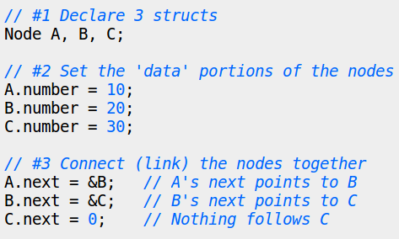



Linked lists
#1
#2
#3

Slide 15
Linked lists
We are declaring (and naming) all of the nodes at compile time
    A list of 30 integers still requires 30 Node's
We have to anonymize elements

Slide 16
Linked lists mechanics
To access an element of an array → we use:
    the name of the array (a pointer to the first element)
    an index (offset from the beginning)
To access an element of a linked list → we use:
    a pointer to the first node
    then walk the list to find a particular node

Slide 17


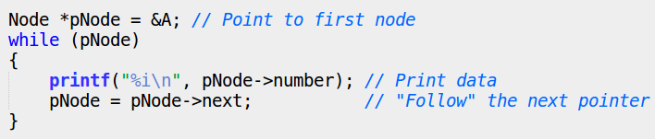
Linked lists mechanics
Print the data for each node
Using unnamed nodes
Loop-based approach

Slide 18

Linked lists mechanics

Slide 19
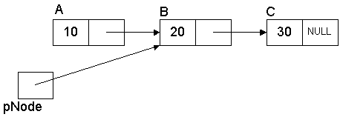
Linked lists mechanics

Slide 20
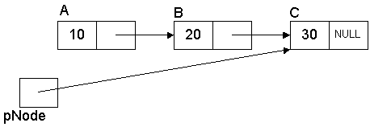
Linked lists mechanics

Slide 21
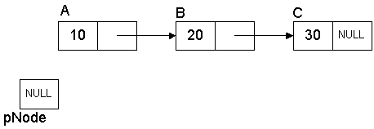
Linked lists mechanics

Slide 22
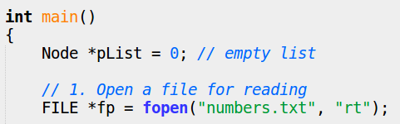

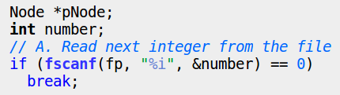

Problem revisited with linked lists

Slide 23
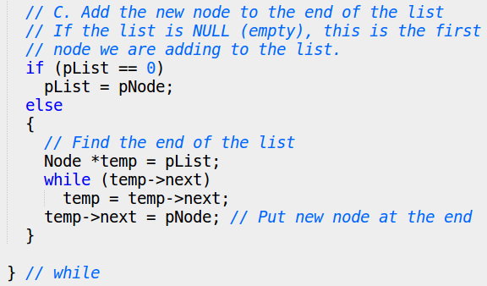
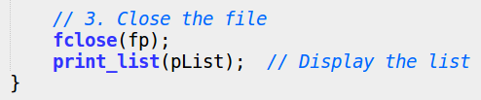
Problem revisited with linked lists

Slide 24
Problem revisited with linked lists
The number of nodes in a linked list is only dependent on the amount of memory in the computer
We are only allocating what we need
There is a 4-byte overhead for each node
The time it takes to add a node to the end of the linked list takes longer as the list grows
We must also remember to deallocate (delete) each node in the list when we are finished

Slide 25
Adding nodes
"The time it takes to add a node to the end of the linked list takes longer as the list grows."
The linked list does not provide random access
    There is immediate access to the first node
    The rest need to be accessed by traversing the list

Slide 26

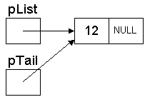
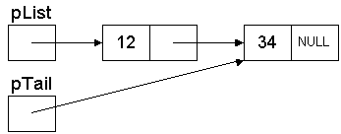
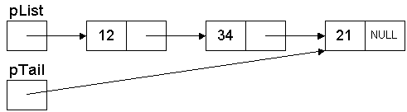
Adding nodes
Workaround #1: have a pointer to the last node (aka tail)
Node * pList = 0;
Node * pTail = 0;
Insert element '12'
Insert element '34'
Insert element '21'

Slide 27
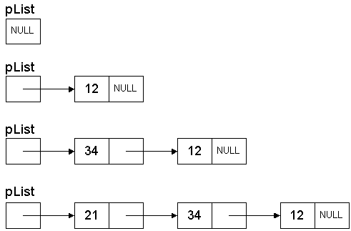
Adding nodes
Workaround #2: insert at the head instead of the tail
Node * pList = 0;
Insert element '12'
Insert element '34'
Insert element '21'

Slide 28
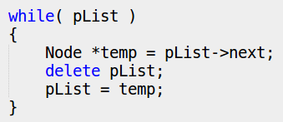
Feeing nodes
We have to call delete on the Node's that were allocated when we're done

Slide 29
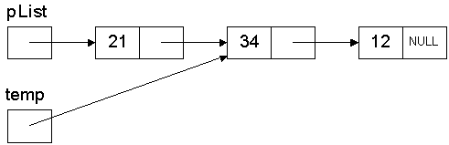
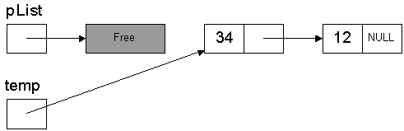
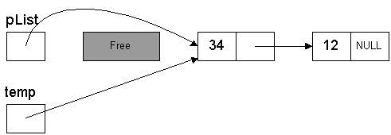
Feeing nodes: first iteration
temp = pList->next;
delete pList;
pList = temp;

Slide 30
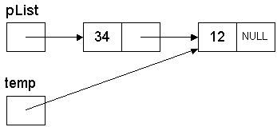
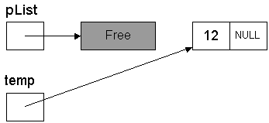
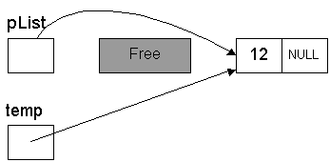
Feeing nodes: second iteration
temp = pList->next;
delete pList;
pList = temp;

Slide 31
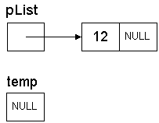
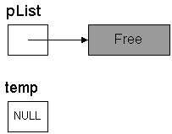

Feeing nodes: third iteration
temp = pList->next;
delete pList;
pList = temp;

Slide 32
Freeing nodes
When we traverse a linked list, we always start from the beginning (head)
We cannot "jump" to a particular node because we don't have random access, like arrays do
We cannot walk backwards through a singly linked list because we have no way to get from a node to the previous node
If you only need to move in one direction, a singly linked list might be enough
If you require bi-directional traversals, you will want to use a doubly linked list, which allows traversals in both directions

Slide 33
Creating functions
In real code, you would create functions to do things such as AddToEnd, AddToFront, DeleteFront, FindItem, etc.
We want to be able to reuse the functionality so that we can perform these operations on any list

Slide 34
Creating functions
However, remember these points about passing parameters to functions:
    If we want a function to change our data, we must pass a pointer to our data
    Passing by value will cause the function to change the copy of the data
    If we just pass the pointer by value (a copy), then the function will change the copy, meaning the copy will point to something else, but the original pointer will be unchanged
    If we want a function to change our pointer, we have to pass a pointer to the pointer

Slide 35
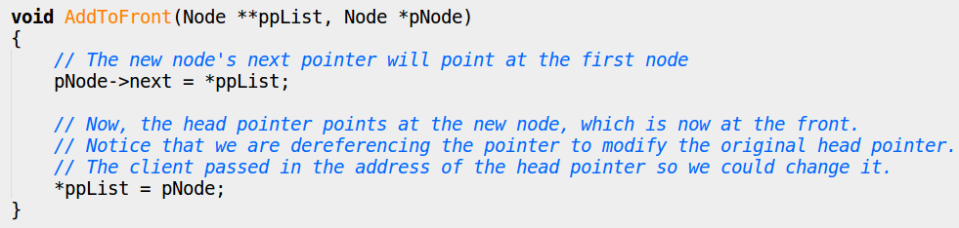
Creating functions
A function AddToFront needs to modify the head pointer → passing the pointer is not enough
    We have to pass a pointer to the head node

Slide 36
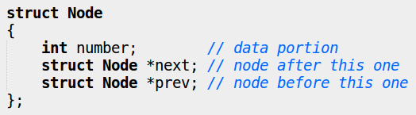

Doubly linked lists
A doubly linked list is a list that has two pointers
    the next pointer
    a previous pointer
This allows you to traverse the list in both directions

Slide 37
Doubly linked lists
Require an extra pointer for each node
Require slightly more work at runtime to "hook-up" the extra pointer
Are more flexible by allowing traversals in both directions
Can be simpler to implement because nodes can access their next and previous node

Slide 38
Conclusion: linked lists...
are an alternate data structure for storing related data
are more complex in structure and more complex in accessing than arrays
require the programmer to deal with the complexity
require more overhead than arrays

Slide 39
Conclusion: linked lists...
can grow and shrink in size at runtime
allow very efficient use of memory since you only allocate what you need
are very efficient for inserting and deleting items at any point in the list

Slide 40
THE END

